Slide 1
RACO Shield-IT
MC-PCS Connector
Code Compliant Solution

Slide 2
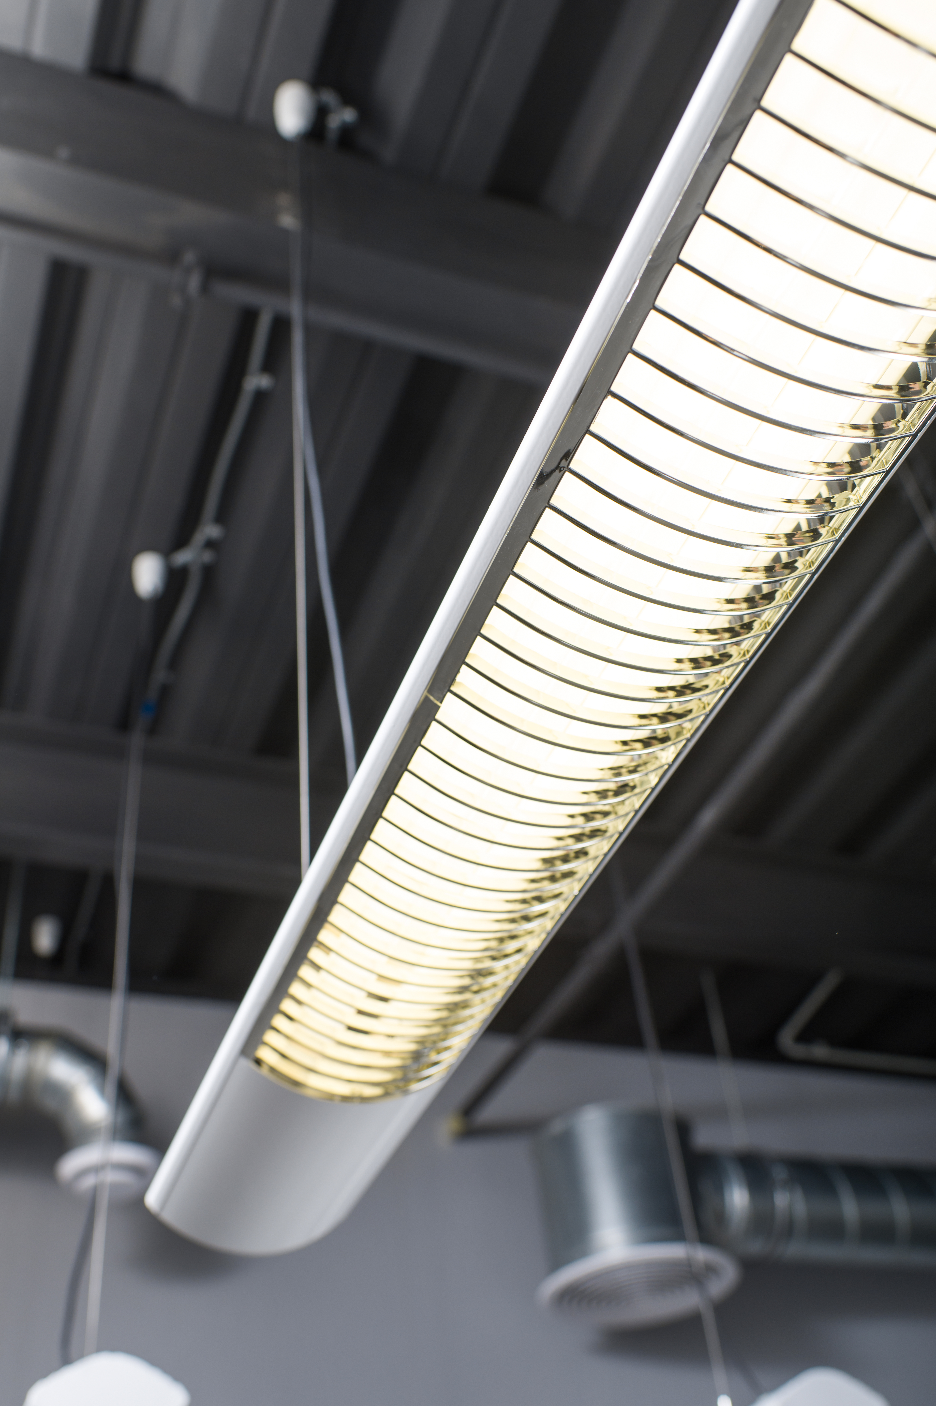
Growing Potential
The commercial lighting market is growing for:
Fluorescent and/or LED Luminaire Dimming
Integrated Lighting Controls
SMART Buildings
MC-PCS cable types growing in popularity
Combine both power and control circuits in one flexible metal-sheathed cable
Used primarily in commercial construction
Reduce installation time and materials
Work with standard MC fittings
Image: Adobe Stock

Slide 3
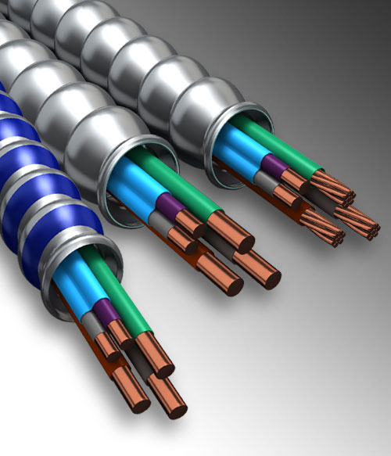
MC-PCS Cable
Features:
2 power-and-lighting conductors and 1 equipment grounding conductor
2 Class 2 control/signal conductors
Allowed by Code because the Class 2 conductors are sheathed in additional insulation
May be surface mounted, fished or embedded
Can be used in Class 1, Class 2 or Class 3 applications
UL Listed
Covered under NEC® Section 725.136 (upcoming revised 2020 NEC Section 330.104)
Image: AFC Cable Systems

Slide 4
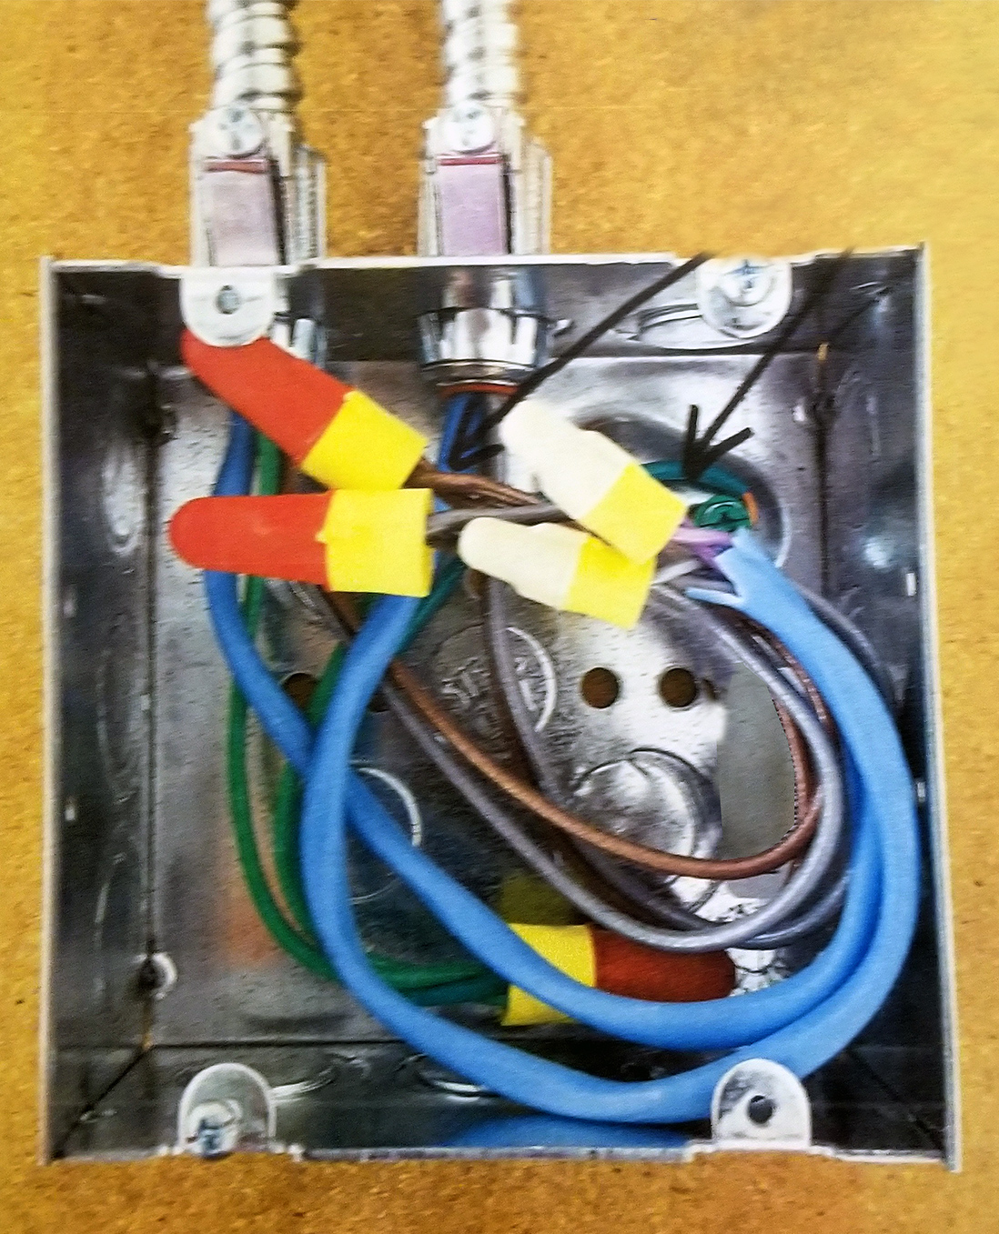
Potential Danger
What happens when the insulation surrounding the Class 2 conductors is removed, to expose the wires for splicing?
NEC 725.136 does not allow power-and-lighting and Class 2 conductors to exist in the same space without certain precautions. (detailed in Sections B through I)
Improperly terminated control wires may become energized by contact with power-and-lighting conductors, creating hazards for users and equipment
Image: NEMA

Slide 5
Code Compliance
NEC 725.136 requires proper separation between power and control/signal wires
Inside the flexible armored cable, the specified 30mil PVC outer jacket over the signal pair creates the appropriate barrier
Safe termination in a box or enclosure is not as clear cut
Barriers
Distance
NEMA simply recommends keeping the outer jacket on control wires to the point of termination, and removing the minimum amount of jacket to make a splice (Bulletin No. 112)
In practice, electrical inspectors are addressing the issues in several ways…
Image: NEMA

Slide 6
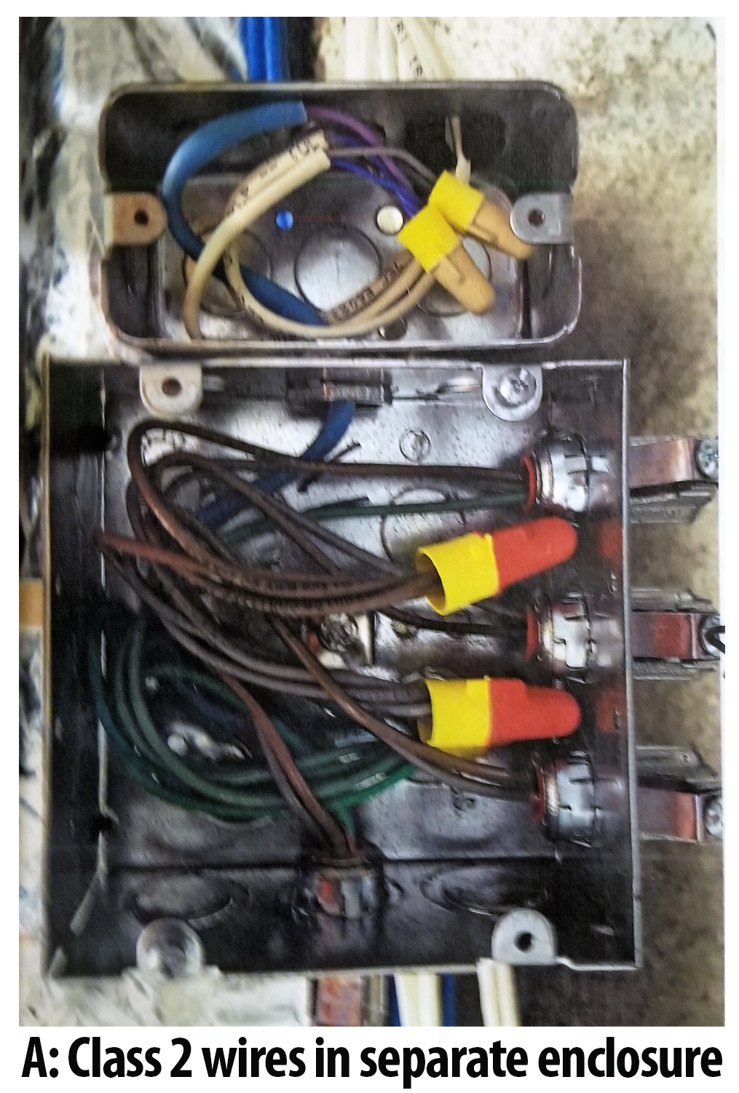
Safest Solution
A)
Require the Class 2 conductors to be spliced in a separate enclosure
Safe
Power-and-lighting conductors are not present
Correct installation best fits the Barrier option
Alternative options include porcelain tubes
Problem for the market: Cost prohibitive
Image: NEMA

Slide 7
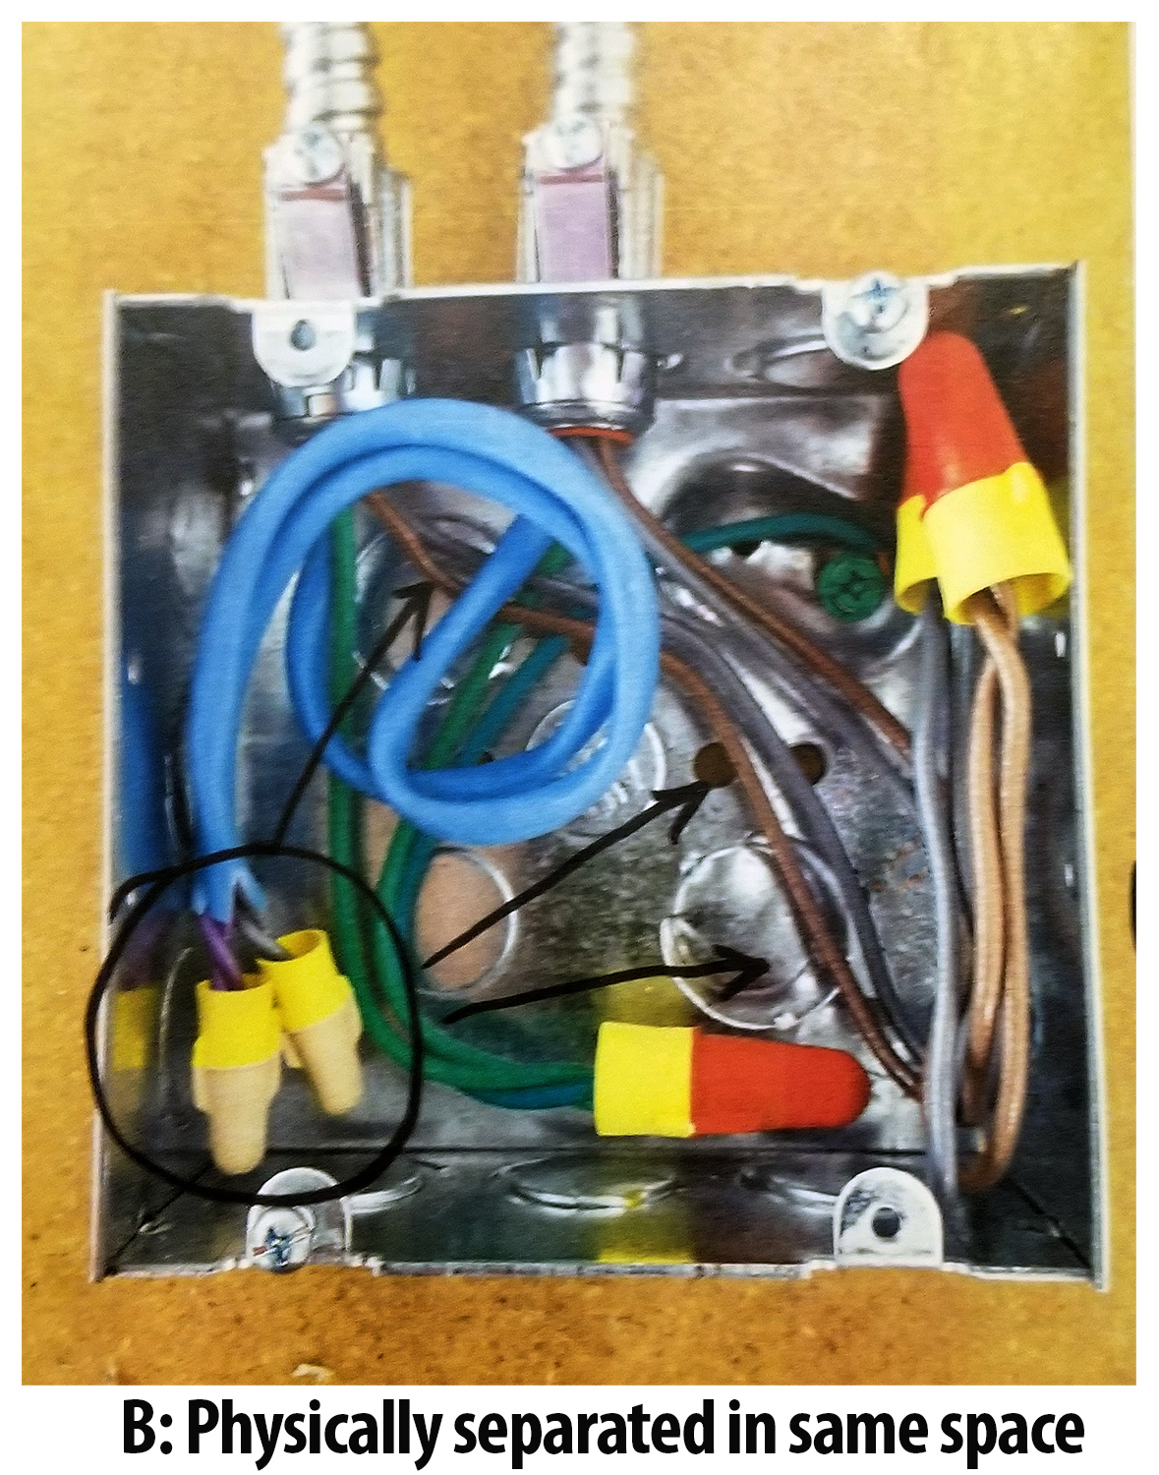
Safer Solution
B)
Physically separate both systems within the same space
Safe
Create a Barrier in the space between the two systems
To fit the Distance option, route wires to maintain 0.25”-2” space (depending on application)
Problem for the market: Often difficult to find room to separate conductors in crowded boxes or fixtures by either barrier or space
Image: NEMA

Slide 8
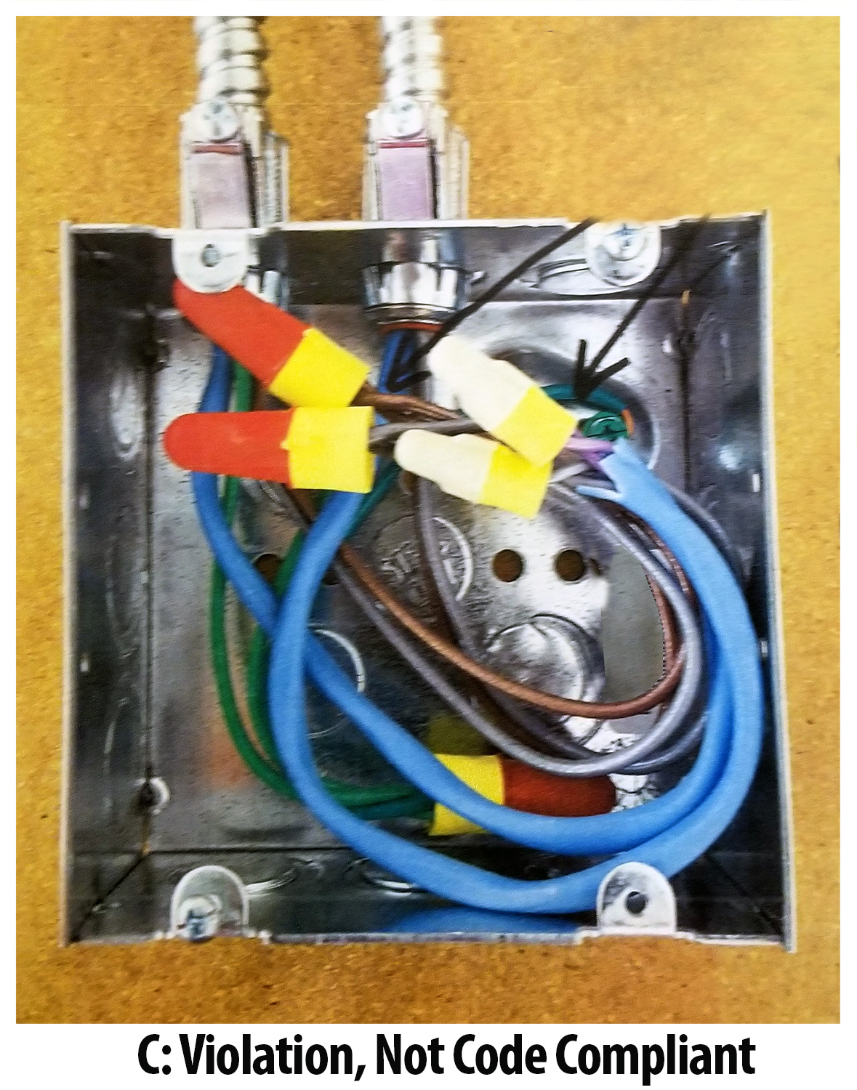
Safe Solution?
C)
Some installations may be approved because the separation is assumed to be ¼”
If not, Inspectors refuse approval of installations such as this
Simply not code-compliant
Simply not safe
Problem for the market: Difficult, in practice, to find room to separate conductors in crowded boxes or fixtures
Image: NEMA

Slide 9
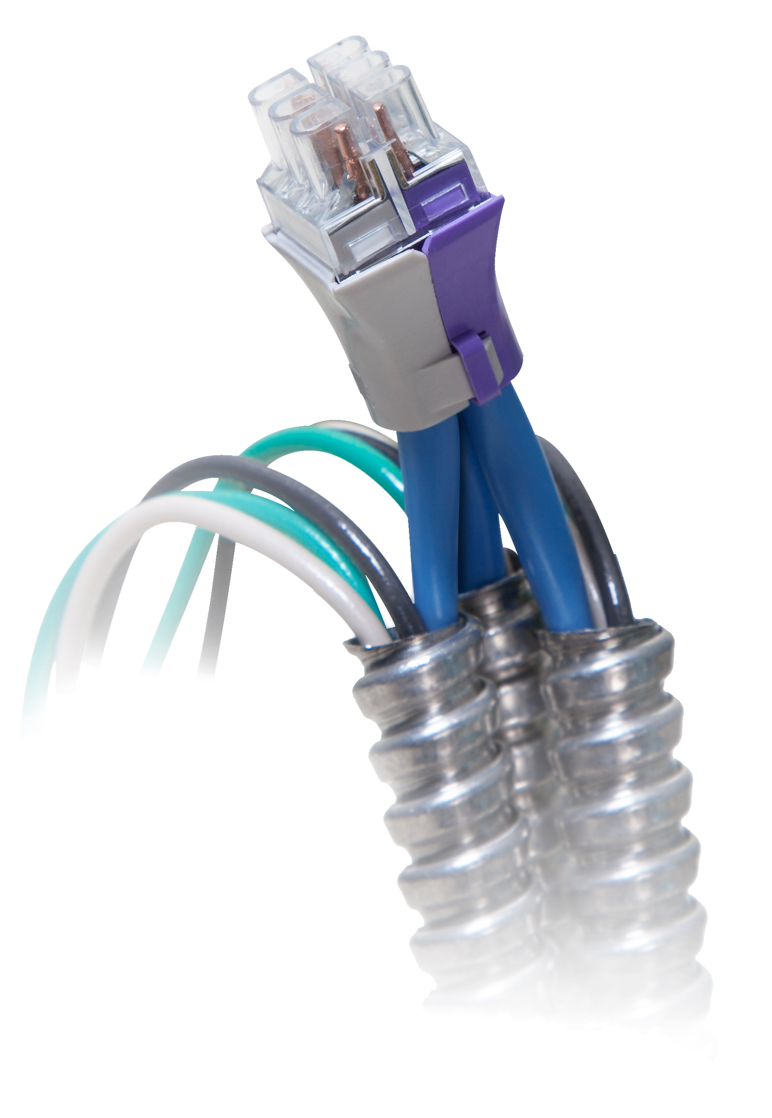
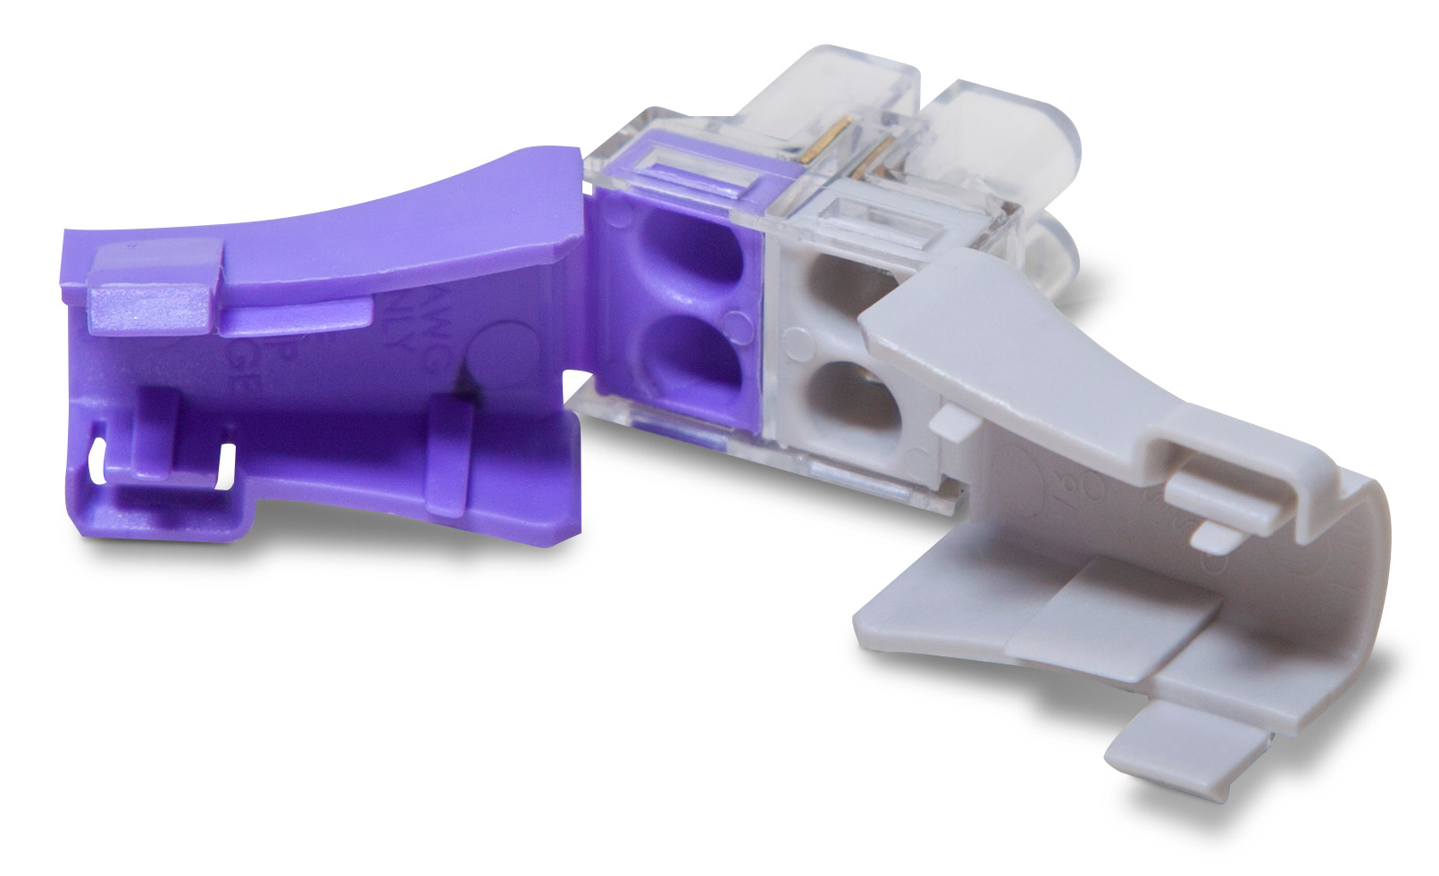
Ultimate Solution
The industry needs a safe, robust, Code-compliant solution
A better solution would be a connector listed for splicing and protecting MC-PCS Class 2 conductors. For example, RACO’s new push-in Shield-IT™️ connector:
Simple
Easy to use
Compact
FAST to install
And easy to verify proper installation
Images: Hubbell

Slide 10
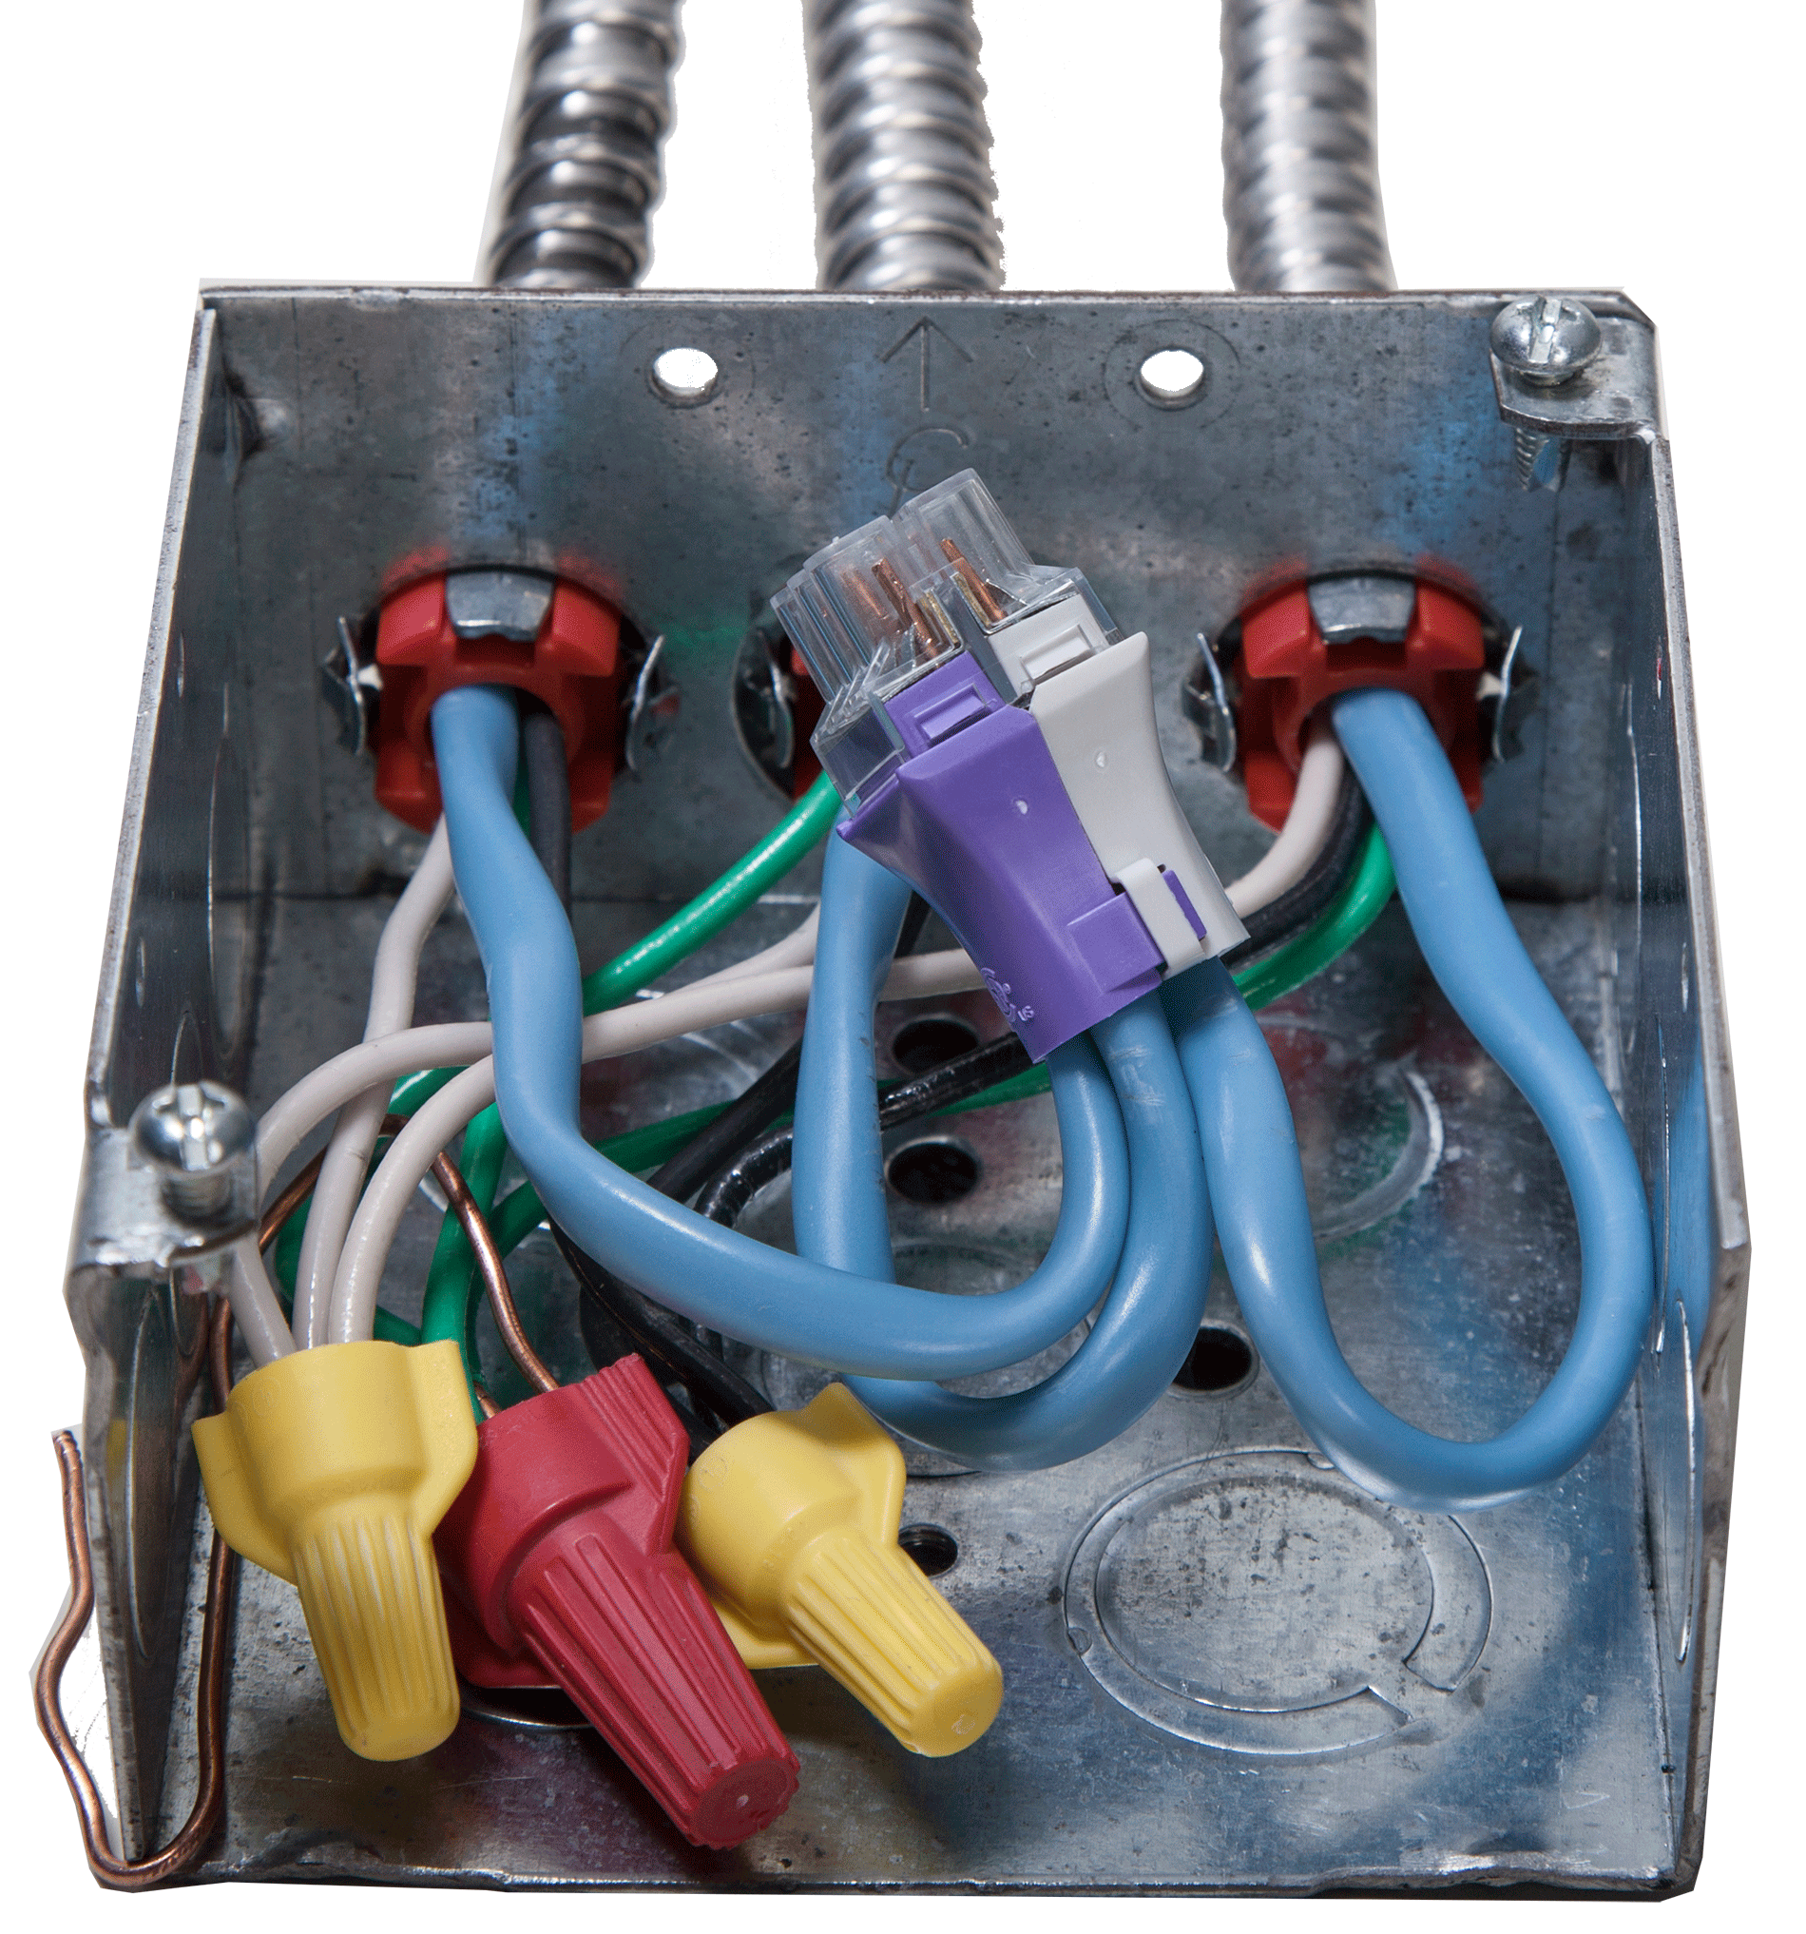
Why it is safer
RACO Shield-IT™️ type connectors feature:
SAFE – Replaces the insulation removed for splicing
Permits CODE COMPLIANCE (UL and CSA Listed)
Eliminates the risk of Class 2 conductors becoming energized by contact with power-and-lighting conductors
Design maintains proper separation
See-thru housing for easy visual inspection
Handle 2-4 pairs per connector
Reduces wiring time by 75%, just strip, push in and snap shut
Stays inside the same box as power-and-lighting conductors
Image: Hubbell

Slide 11
The Role of Inspectors
Electrical inspectors are the key to the industry adopting superior solutions
Promoting SAFE installations
Ensuring code-compliant installations, whether physically separated or using Listed connectors

Slide 12
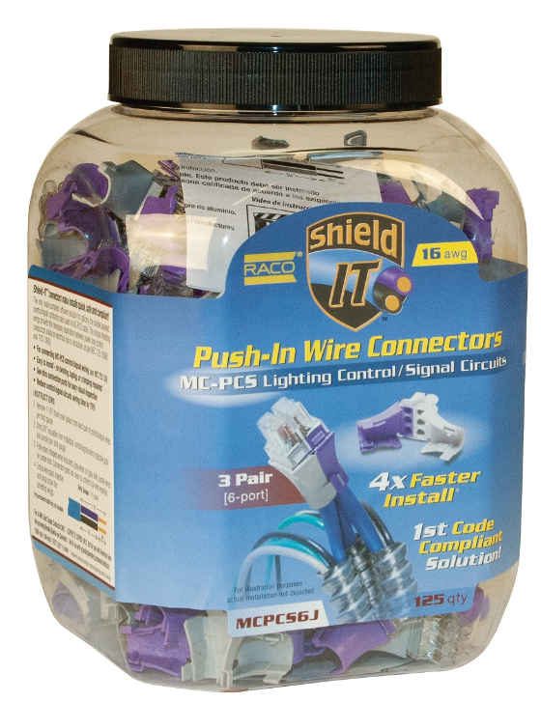
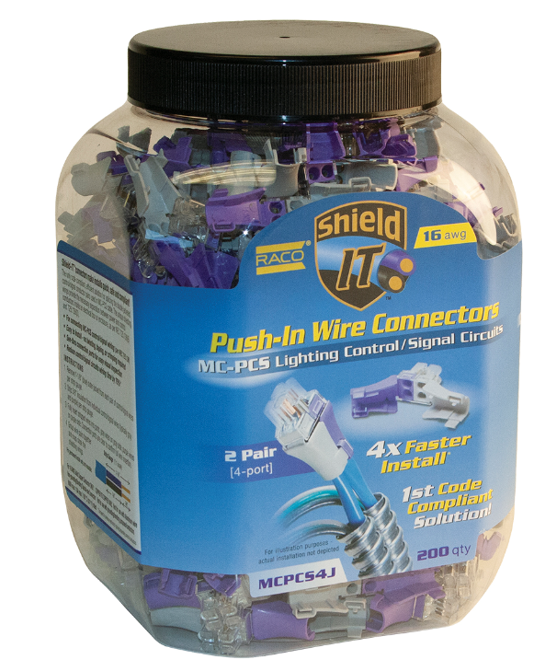
The RACO SHIELD-IT Offering
https://youtu.be/-A__2CO1nm8

Slide 13
QUESTIONS?

